Slide 1
M Abdul Rehman Shakeel
BS Computer Science, National Textile University
CGPA: 3.08/4.00

Slide 2
Introduction
From a family of Computer Science enthusiasts.
Passionate about Machine Learning and Deep Learning.
Notes:
My name is Ammara Akhtar. I am currently in the 7th semester of BS in Computer Science at National Textile University with a CGPA of 3.91. I am passionate about Machine Learning, and I also have a strong interest in Data Visualization and Automation.

Slide 3
Experience and Skills
Practical Experience in Machine Learning
FortiQore Pvt. Ltd. Faisalabad, Pakistan (01 July 2025 – 15 September 2025)
Responsibilities:
Collected and cleaned data.
Prepared data for machine learning models.
Trained machine learning models on real data.
Checked model results and performance.
Built user interface using Stream lit and connected machine learning models on the backend..

Slide 4
Experience and Skills
Research Experience
Final Year Project – Real-Time Child Monitoring and Alert System
Developed an AI-based app that monitors a child’s activity and sends real-time notifications to parents if inappropriate content is detected.
Implemented automatic website/app blocking until parents unblock.
Gained experience in machine learning, pattern recognition, and real-time system automation.

Slide 5
Experience and Skills
Semester Project of Machine Learning Course
National Textile University Faisalabad, Pakistan (15 Nov 2025 – 5 Jan 2026)
RealTime Rainfall Prediction
Trained ML model using Kaggle weather dataset.
Pre-processed data and selected relevant features.
Integrated OpenWeather API for real-time weather data.
Extracted live features based on user-selected location.
Passed real-time data to trained model for prediction.
Predicted Rain / No Rain using machine learning.
Built a simple Streamlit interface for users.

Slide 6
Experience and Skills
Semester Project of Introduction To AI Course
National Textile University Faisalabad, Pakistan (15 April 2025 –20 June 2025)
Data Anonymization and Its Trade-offs
Cleaned and preprocessed real-world datasets.
Applied data anonymization techniques to protect sensitive information.
Trained models on original and anonymized data.
Evaluated and compared model accuracy in both cases.
Analyzed the impact of anonymization on data quality and accuracy.
Studied the trade-off between privacy protection and model performance.
Notes:
Data anonymization is the process of protecting people’s privacy by removing or modifying personal or sensitive information in a dataset so that individuals cannot be identified.

Slide 7
Experience and Skill
Practical Experience in Python
CosmiCode Pvt. Ltd. Faisalabad, Pakistan (01 Aug 2025 – 30 Oct 2025)
Responsibilities:
Worked as a Python Intern and practiced Python programming on real tasks.
Wrote basic Python programs for problem-solving and logic building.
Worked on data handling using lists, dictionaries, and files.
Used Python libraries like NumPy and Pandas (basic level).
Learned debugging and fixing errors in Python code.
Followed clean coding practices and proper program structure.
Improved logical thinking and confidence in Python programming.

Slide 8
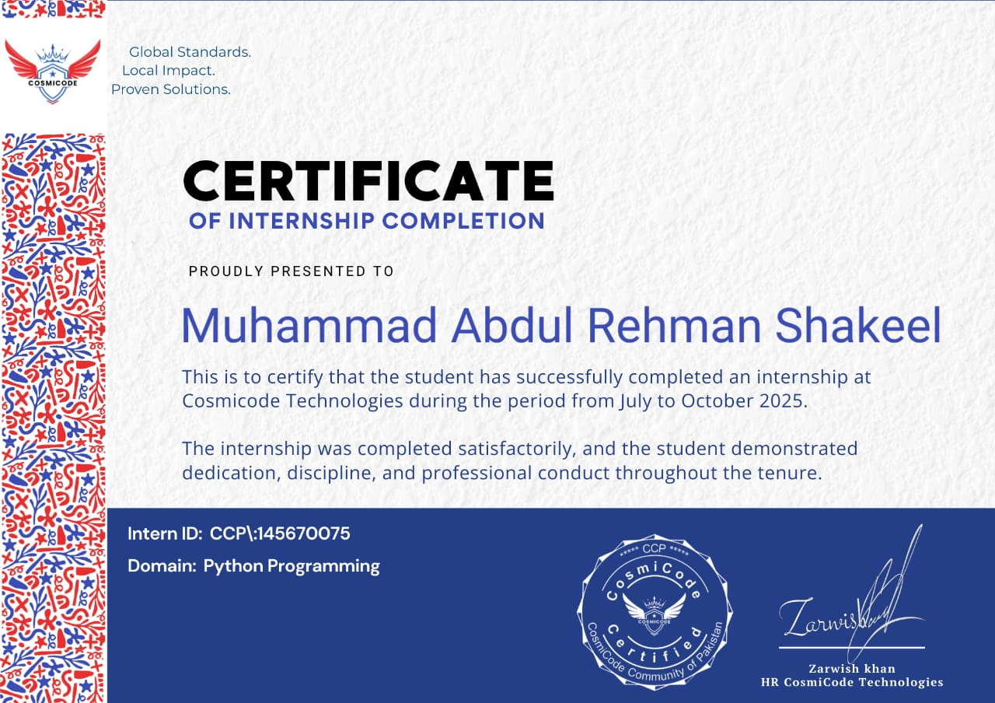


Slide 9
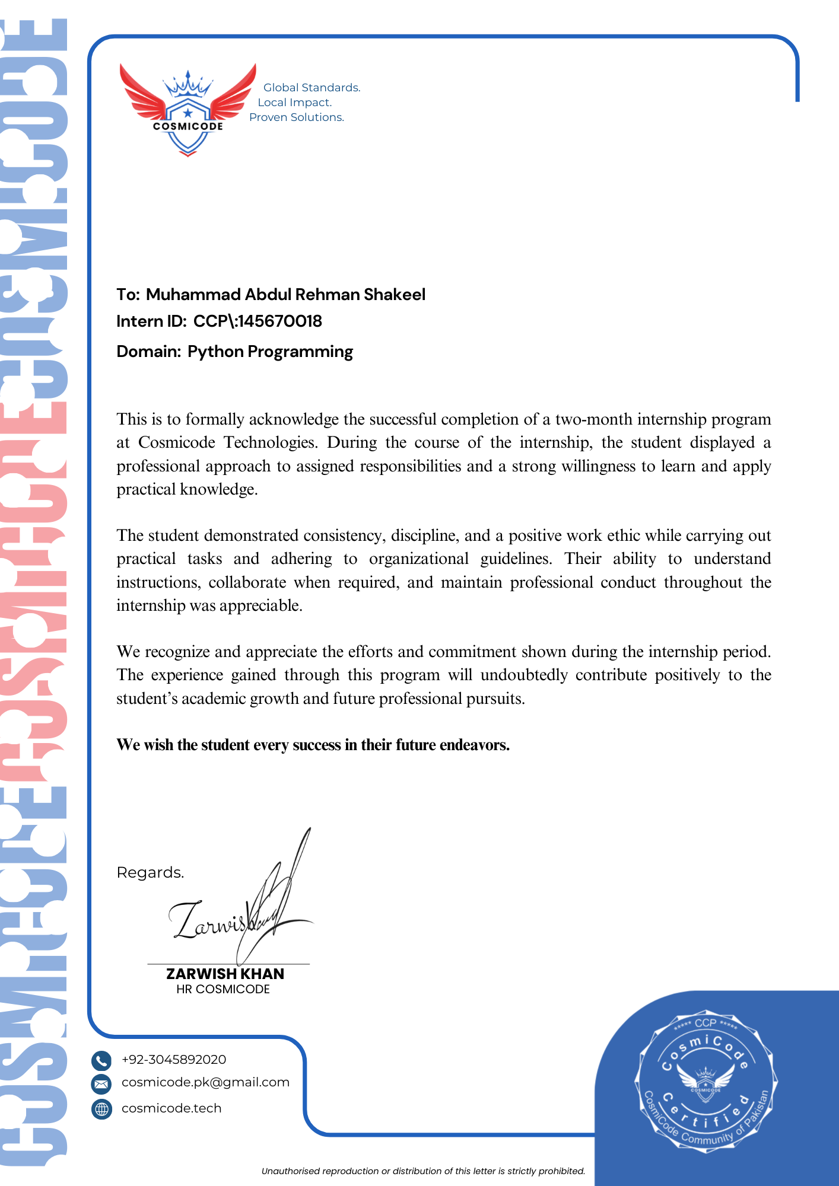

Slide 10
Experience and Skill
PFTP Final Project
Sentiment Analysis System
Collected dataset from Kaggle.
Performed data preprocessing:
Removed stop words
Cleaned HTML tags
Removed emojis and special characters
Converted text into numerical representations using embedding techniques suitable for machine learning models.
Trained ML models to classify text sentiment (e.g., positive, negative, neutral).
Evaluated the model to ensure accurate sentiment predictions.

Slide 11
CERTIFICATES

Slide 12
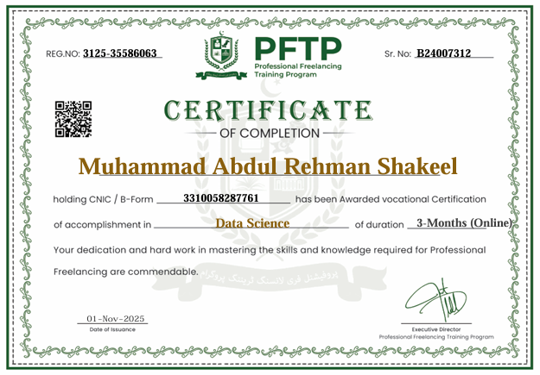

Slide 13
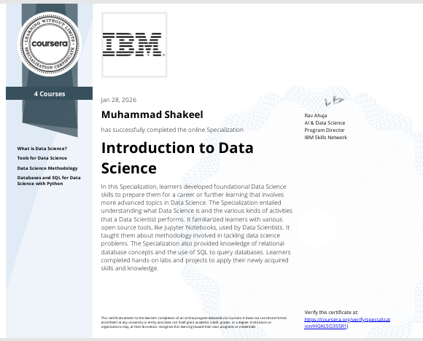

Slide 14
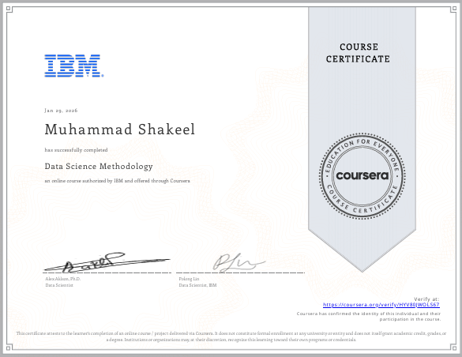

Slide 15
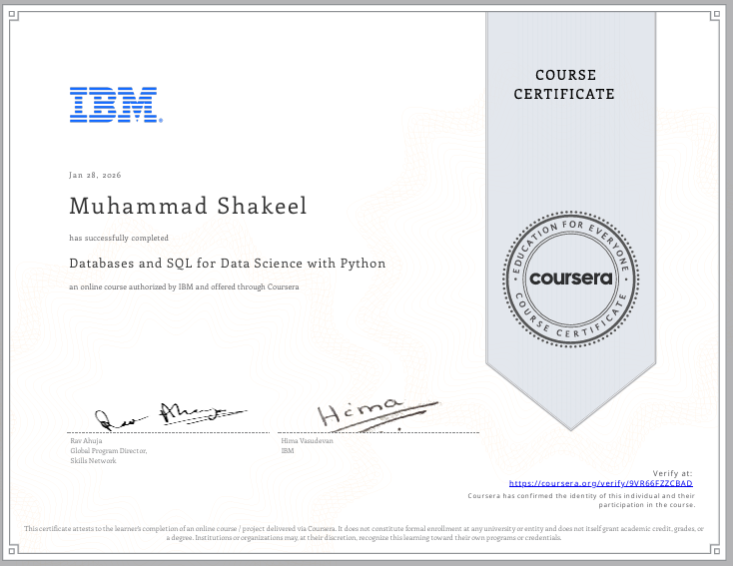

Slide 16
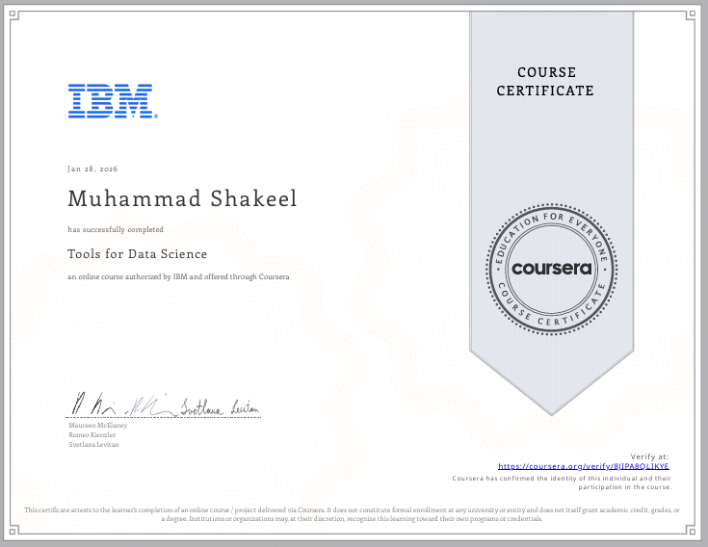

Slide 17
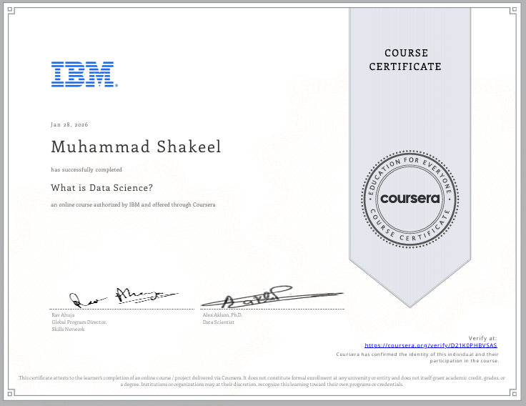

Slide 18
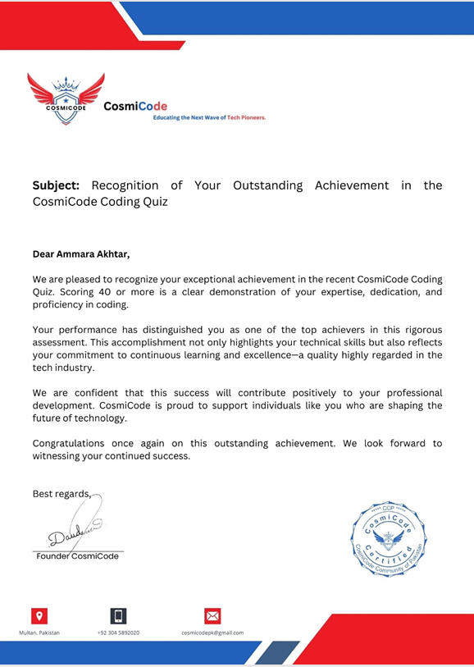

Slide 19
Experience and Skills
Soft-Skills
Good at solving problems and thinking clearly
Can work well with others and communicate ideas
Manage time and adapt to changes easily
Careful and pay attention to details
Take initiative and can lead when needed
Creative and think of new ideas
Patient and keep trying until I succeed
Learn new things quickly

Slide 20
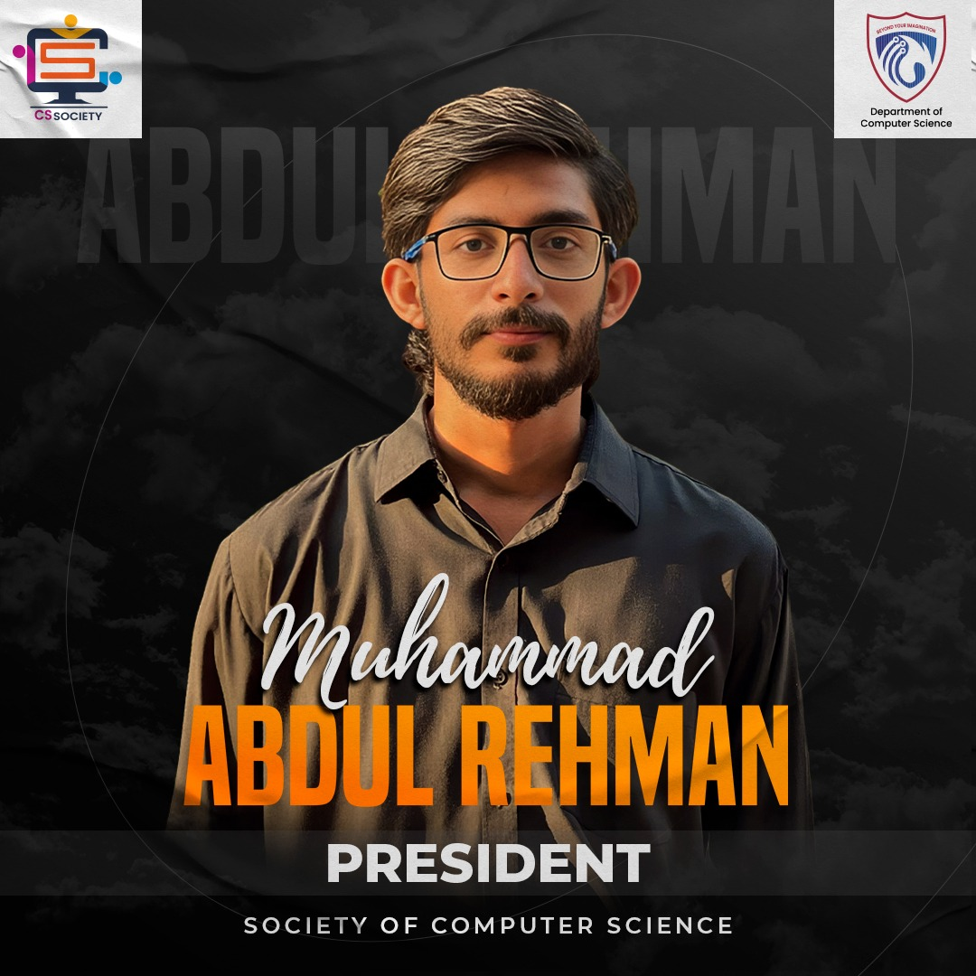
Some Glimpse of Extracurricular Activities:
Co-President, Society of Computer Science (15 Oct 2025 - …..)
Organized seminars, talks, and career guidance sessions for students.
Invited industry experts and speakers to share knowledge.
Planned workshops and activities to help students learn new skills.
Encouraged student participation in society events.

Slide 21
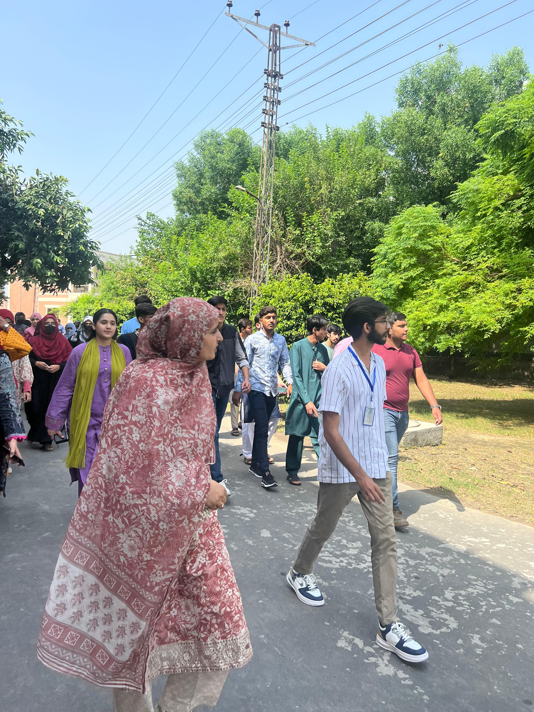
Extracurricular Activities:
Junior Orientation Committee Member(23 Sep 2025 )
Helped organize the orientation for new students.
Guided and supported freshmen during their first days.
Assisted in running events and activities smoothly.
Worked with the team to make the program welcoming and fun

Slide 22
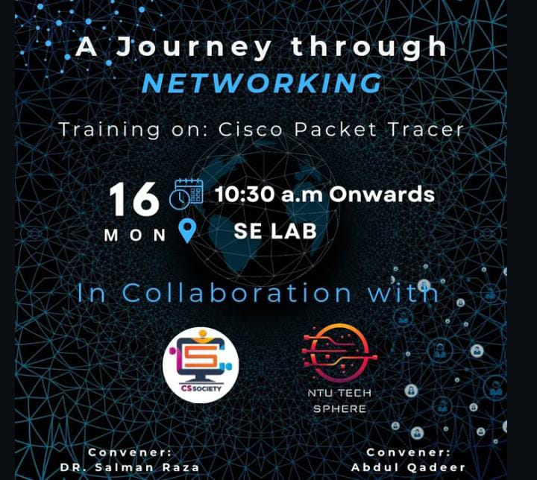
Extracurricular Activities:
Management during the Cisco Packet Training session
Helped manage and organize the Cisco Packet Training session.
Assisted trainers and participants during the session.
Ensured the session ran smoothly and on time.
Supported technical setup and materials as needed.

Slide 23
Thank You

